Slide 1
CSI4999 - Project 6
Rec Center Management
Sprint 2 Presentation
By: Eapen James, Noah Giles, Aaron Goodfellow, Tyler Streu, Taylor Piot, Doris Gjata, Eric Myllyoja

Slide 2
Sprint 2’s User Stories We focused on
As a User, I can login into my account in order to access the system.
As a User, I can sign up for an account.
As an Administrator, I will be able to lock and unlock user accounts.
As a User, I will be able to change my profile or update my information.
As an Administrator, I can create accounts for other users or administrators.
Notes:
Eapen

Slide 3
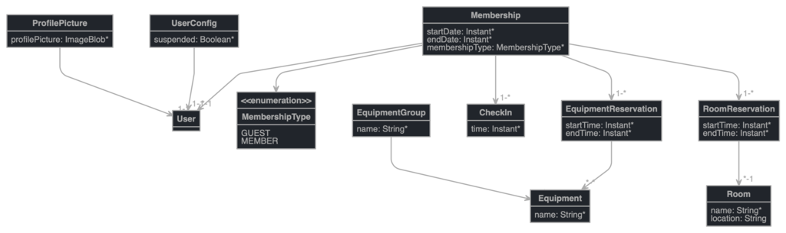
Entity Diagram
Notes:
Noah and Eric

Slide 4
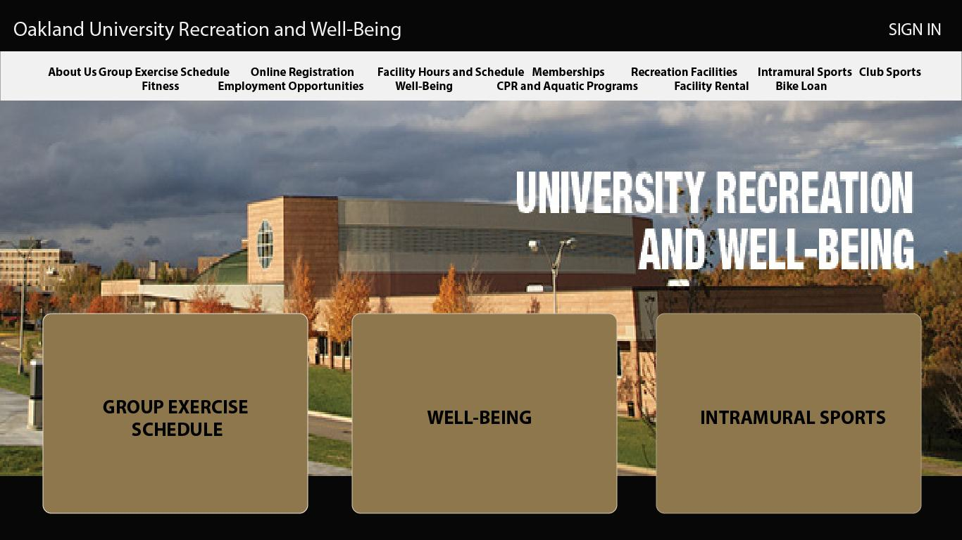
Design of UI
Notes:
Taylor

Slide 5
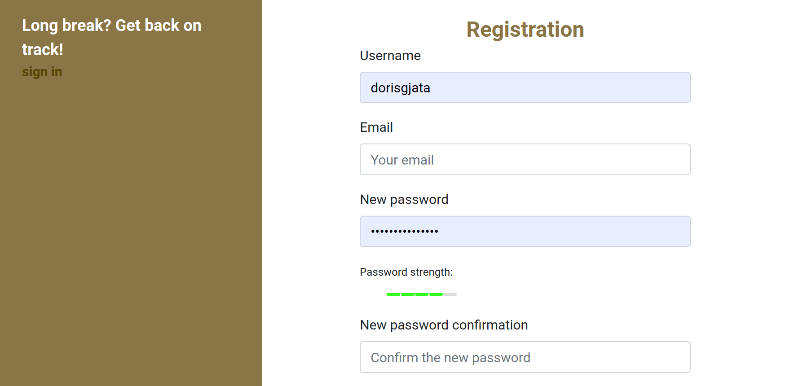
Register
Notes:
Doris

Slide 6
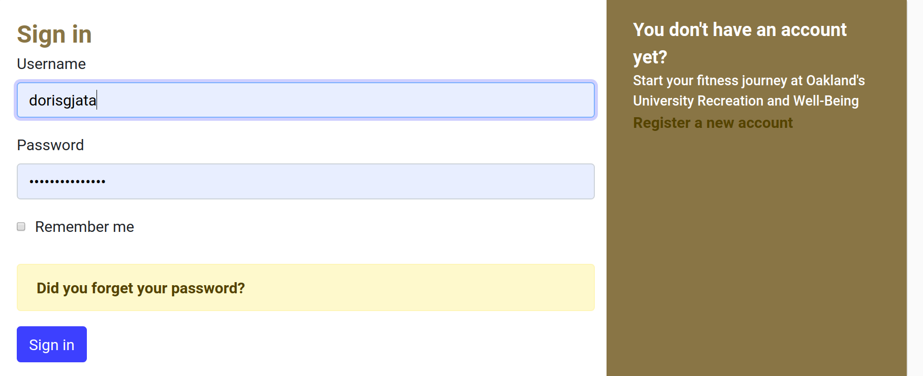
Login
Notes:
Doris

Slide 7
QA Testing
User account can be created
User can sign in to their account
User can log out of their account
Admin has more privileges than user
Admin can enable/disable user accounts
Email verification sends link
Users / Admins can change their password
Users / Admins can get help with forgotten passwords
Notes:
Eric

Slide 8
Risks and Challenges
Frontend and UI implementation
JHipster’s Frontend framework is a mess
We are thinking of changing it
We may just keep the default JHipster and just modify
Backend confusions
Similar to the frontend confusion
Team Organization
Notes:
Aaron
To be edited

Slide 9
DEMO
Notes:
Aaron with anyone else chiming in about their future plans

Slide 10
Next Sprint Objectives
First week plan for next sprint: Facility Backend Logic / Facility Rental UI / Backlog
Next Sprint Specifics
Implement custom UI for user login
Create facility entities
Basic Facility Rental UI
Membership type UI
Clarify more after class
Notes:
Tyler

